Slide 1
Kickstarter Database Analysis
By Fayza AlMukharreq

Slide 2
Overview
The database used in this analysis is “Kickstarter Projects” which can be accessed through this link:
https://www.kaggle.com/kemical/kickstarter-projects
The database is collected from Kickstarter Platform and covers all projects launched on the platform for the period 2009 to 2018.
The objective of this analysis to provide descriptive analysis of the data and to see if we can build a relationship between any of the parameters (country, category, ..etc) and state (success/failure) of the project

Slide 3
Database Structure
ID : internal kickstarter id
name : name of project - A project is a finite work with a clear goal that you’d like to bring to life.
category : category
main_category : category of campaign
currency : currency used to support
deadline : deadline for crowdfunding
goal : The funding goal is the amount of money that a creator needs to complete their project.
launched : date launched
pledged : pledged amount in the project currency
state : Current condition the project is in
backers : number of supporters who pledged the project
country : country of the project
usd_pledged: conversion in US dollars of the pledged column (conversion done by kickstarter).
usd pledge real: conversion in US dollars of the pledged column (conversion from Fixer.io API).
usd goal real: conversion in US dollars of the goal column (conversion from Fixer.io API).

Slide 4
Data Cleaning
Few records for Year 1970 removed from the database
“usd pledge real” was used in the analysis instead of “usd_pledged“ for evaluating the pledged amount in USD because the data in “usd_pledged” is incomplete and doesn’t always match “pledged” for projects in USD currency.
“main_category” was used through the Analysis because 27% of the projects are using the same generic “main_category” as sub-category
Year | 1970 | 2009 | 2010 | 2011 | 2012 | 2013 | 2014 | 2015 | 2016 | 2017 | 2018
Projects | 7 | 1,329 | 10,519 | 26,237 | 41,165 | 44,851 | 67,745 | 77,300 | 57,184 | 52,200 | 124
main_category matches category | Total | Pct
False | 277,615 | 73%
True | 101,039 | 27%
Total | 378654

Slide 5
Kickstarter Database
Data science team

Slide 6
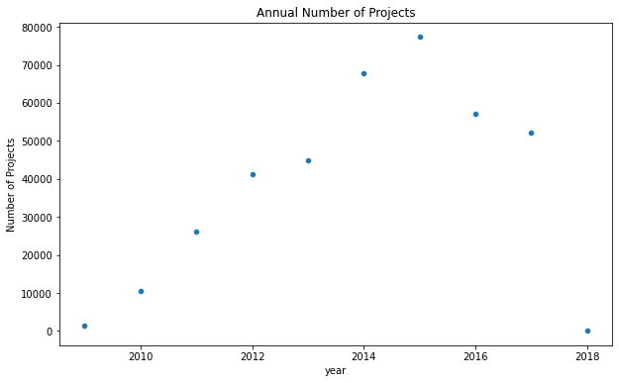
Projects per Year: steady growth in number of projects from 2009 to 2015 then sudden drop in 2016 and 2017

Slide 7
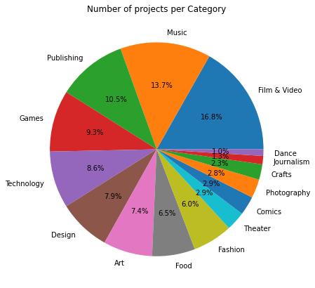
Number of projects per Category: Films & Video, Music, publishing and games account for 50% of the total projects. Technology comes afterward with 8.6% of the projects

Slide 8
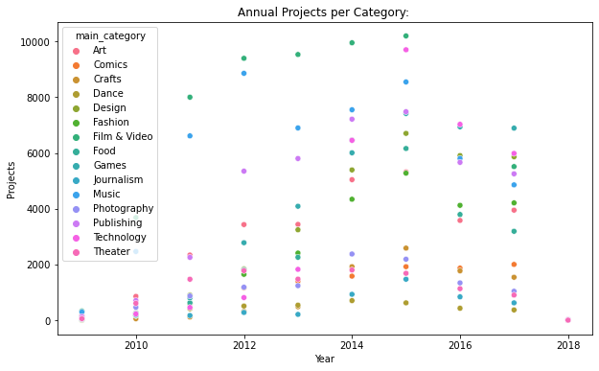
Annual Projects per Category: The distribution of projects in different categories seems to be constant with Films & Video & Music taking the lead – Technology has grown significantly since 2015

Slide 9
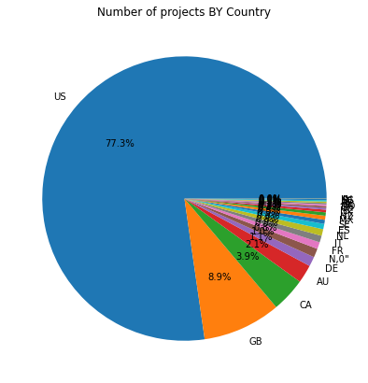
Projects by Country: Kickstarter is more popular in USA (77%)followed by GB & CA

Slide 10
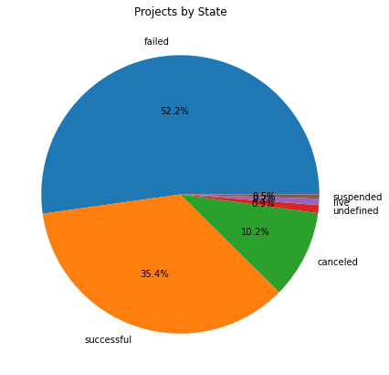
Projects by Stat: 52% of the projects has failed and 10% were cancelled while only 35% were successful to achieve their gaol

Slide 11
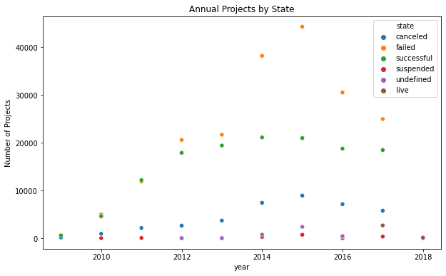
Annual Projects by State: stable number of successful projects in 2012 to 2017 while increase in failed project until 2015 then dropped as total number of projects dropped

Slide 12
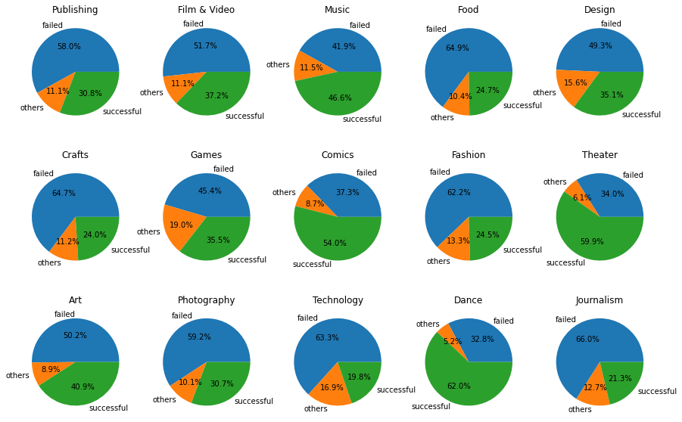
State by Category: Dance, Theatre and Comics had the highest success rate while Technology, Journalism, Crafts and Food had the least success rate

Slide 13
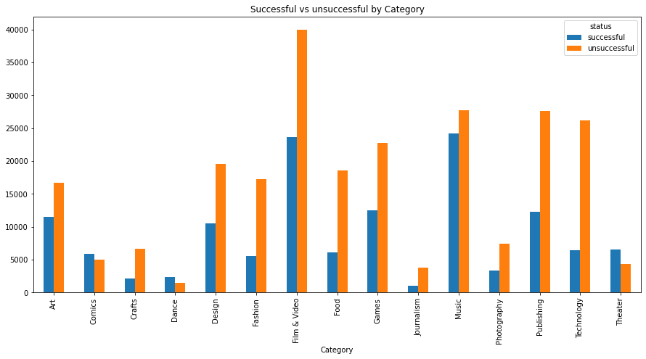
State by Category: Although Dance, Theatre and Comics have better success rate, the total number of projects and number of successful projects is very small. In absolute, Films & Videos and Music are dominating in both success and failure.

Slide 14
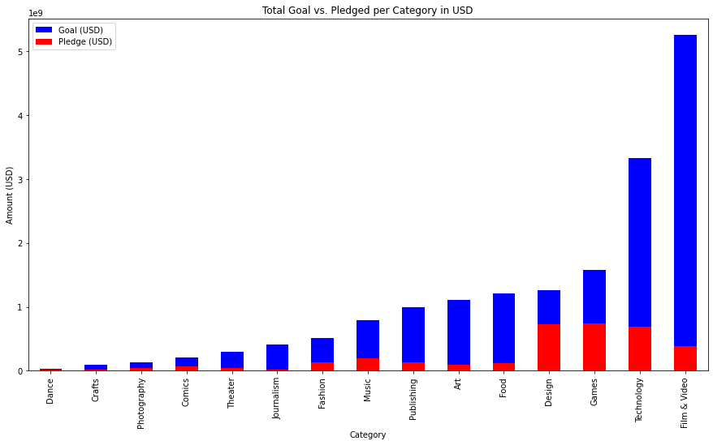
Total Goal vs. Pledged Amount per Category: Films & Videos had the highest Goal followed by Technology While Games and Design had the highest pledged Amount

Slide 15
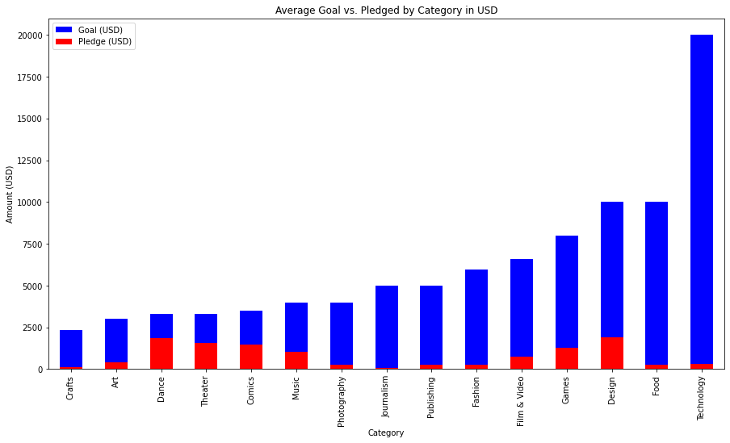
Average Goal vs. Pledged Amount per Category: on average, highest amount was pledged toward Dance, Theatre, Design and Comics. Technology projects are the most expensive.

Slide 16
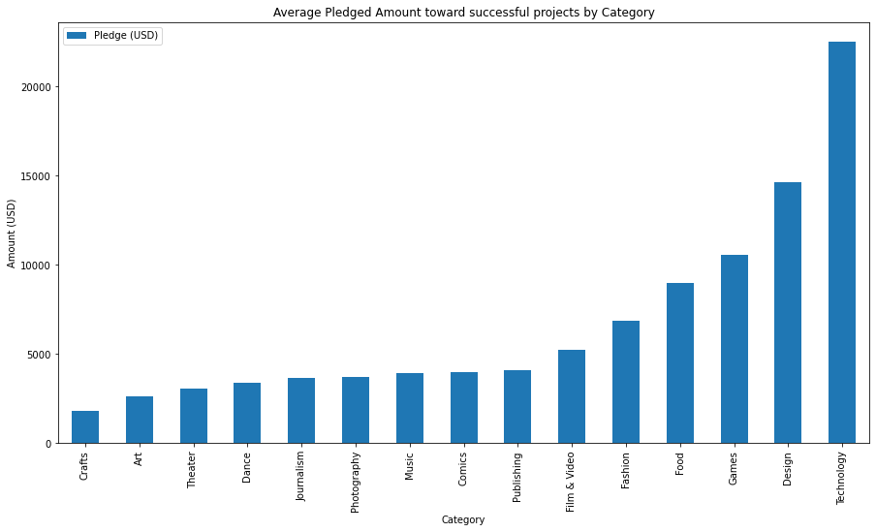
Average Pledged Amount per Category for successful projects: Technology projects requires more support followed by Design and Games

Slide 17
Kickstarter Database
CEO

Slide 18
Annual Projects by State: stable number of successful projects in 2012 to 2017 and drop in failed projects.

Slide 19
Number of projects per Category: Films & Video, Music, publishing and games account for 50% of the total projects.

Slide 20
State by Category: Films & Videos and Music have significant number of successful projects with risk of failure

Slide 21
Average Pledged Amount per Category for successful projects: Technology projects are the most expensive then Design and Games

Slide 22
Conclusion
Kickstarter platform continue to grow over the years until 2015 then started to decline:
Number of successful projects is consistent over the years.
Number for failed projects has gone down since 2015.
It could be an indication that the quality of projects has gone up since 2015.
Smaller projects with less fund required seems to be more successful in achieving their targets
Films & Videos and Music are the most popular over the year in both Total Number of Projects and Number of Successful projects
Technology Projects are the most expensive which could be the reason why thy fail to achieve their Goal

